Slide 1
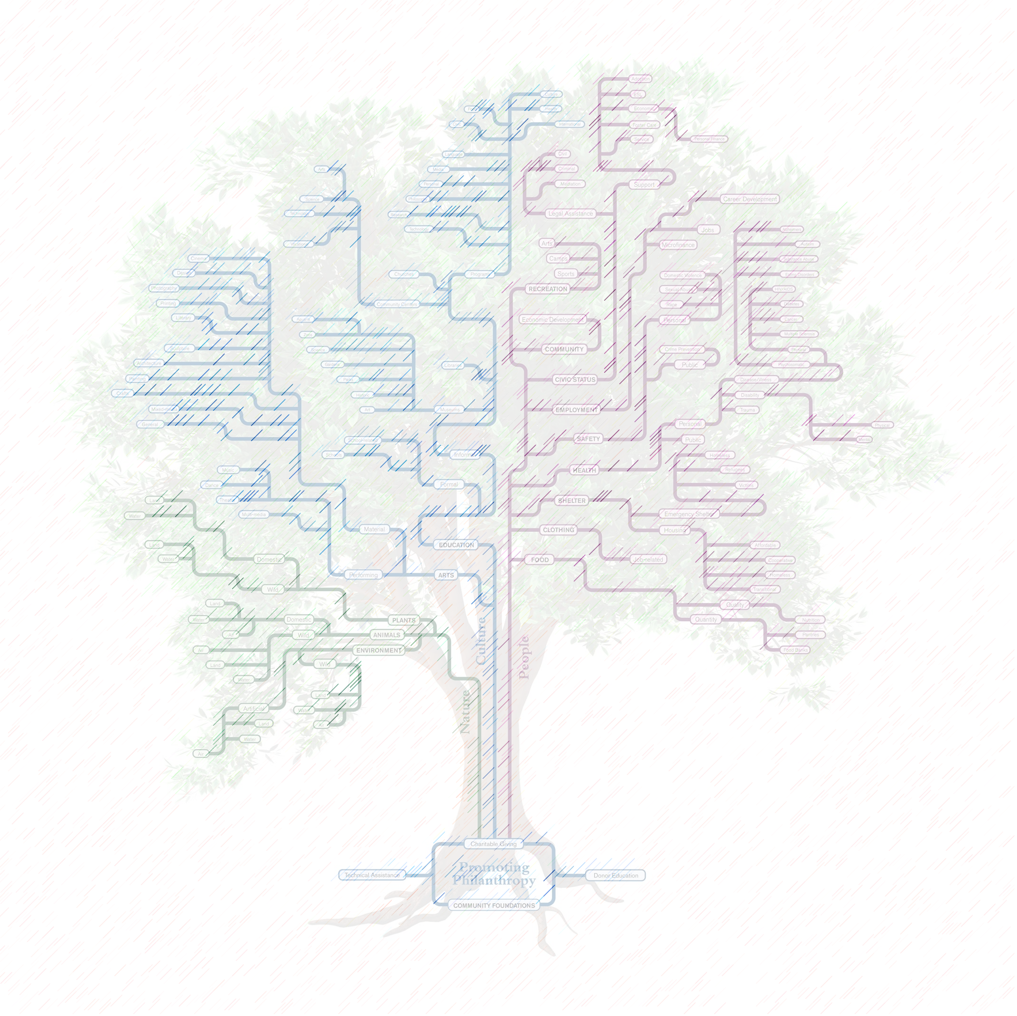
Terminology - Threat
An undesired action or outcome against an asset
If it doesn’t affect an asset, it’s not a threat
If it doesn’t cost resources… it’s probably not a threat
Example threats:
Loss of credit card numbers
Loss of network connectivity
Inability to log in to the system

Slide 2

The Tabular System & Attack Trees
Notes:
This shows an example of an Attack Tree. Be aware that students’ trees may be completely different. This is to show the students a sample Attack Tree for their reference.

Slide 3
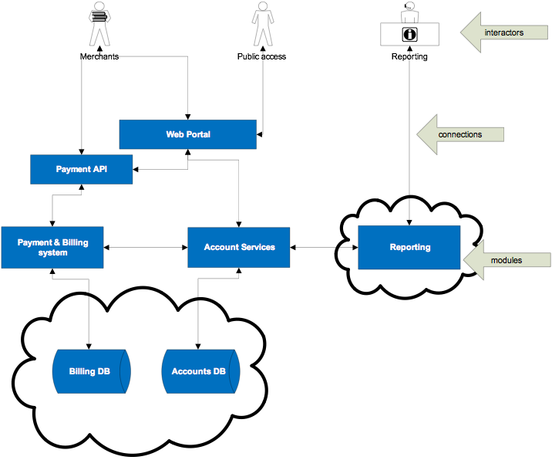
Data Flow Diagramming Example
Notes:
The full trust boundary is in green. The partial trust boundary is in red. The Reporting team is not under the full control of the owners of the ARchitecture, hence the partial trust. This effectively means that extra controls have to exist on the Reporting team, such as extra authorization.

Slide 4
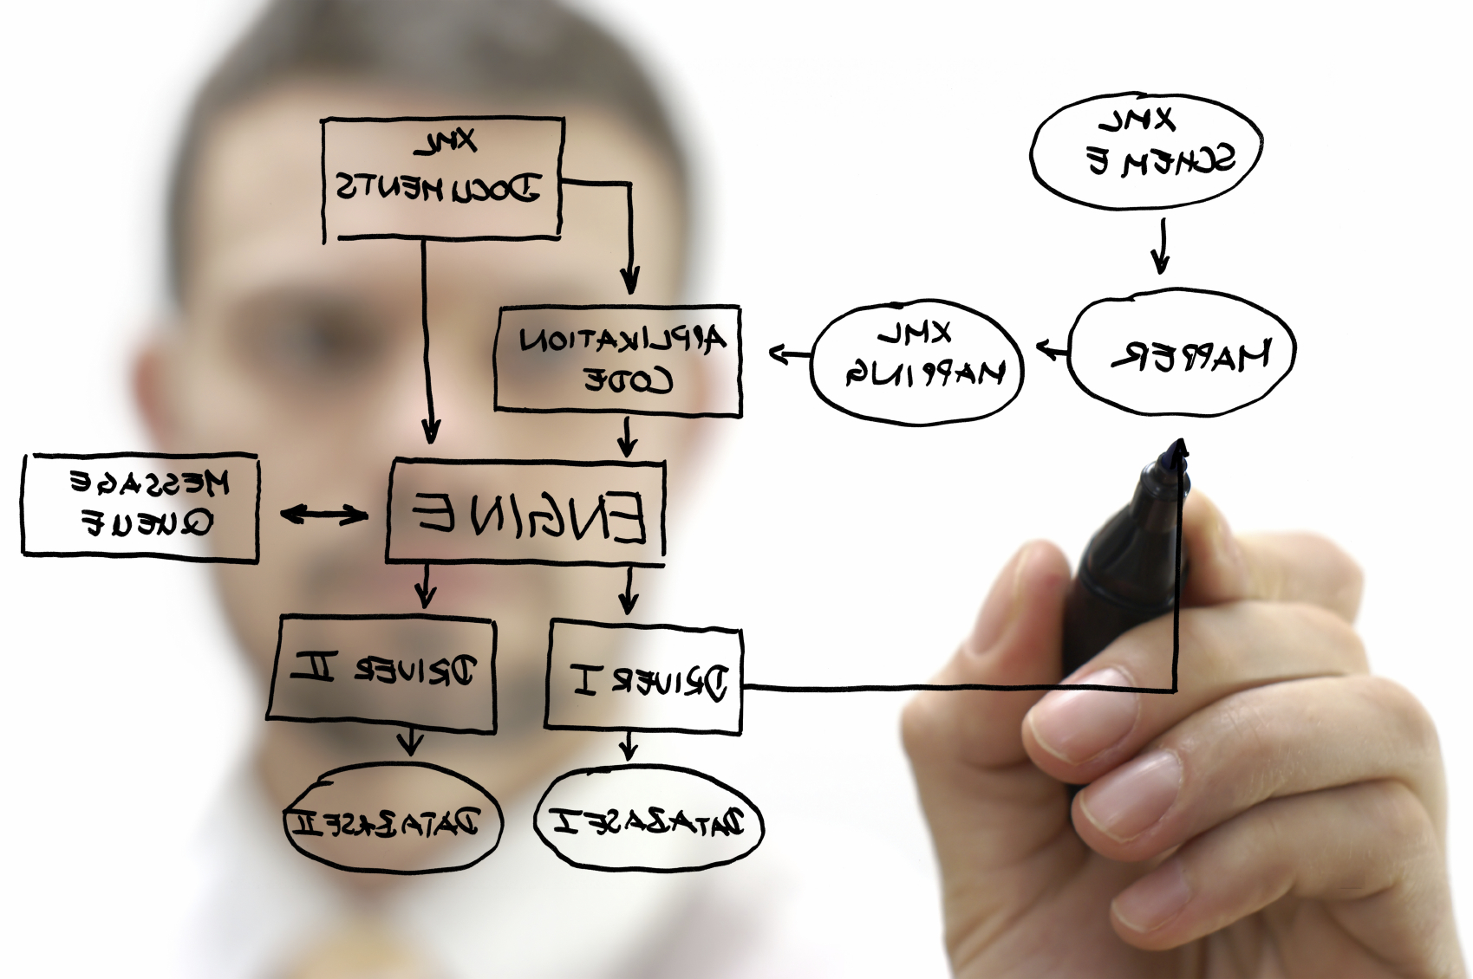
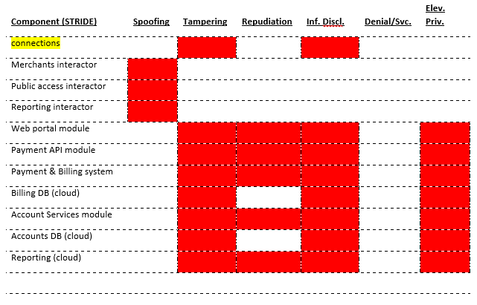
System Modelling & Threat Analysis STRIDE Threats

Slide 5
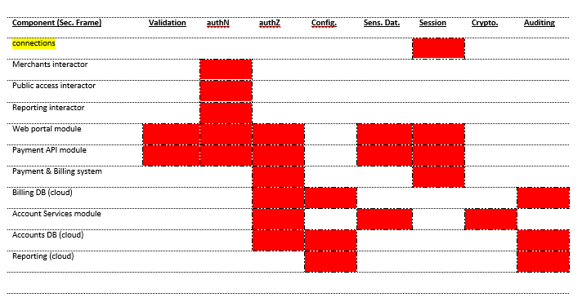
System Modelling & Threat Analysis Security Frame Threats

Slide 6
Mitigation Analysis & Verification Lab Exercise – Apply Mitigations!
20 minutes - Each group associates mitigations to the Threats
Use the DFD that was created in the previous exercise
Apply a mitigation to each STRIDE or Security Frame element that is annotated to a DFD element
eg. An annotated dataflow (TAMPERING or Data Validation) gets a Validation mitigation
5 minutes – Review
Presenter will show a solution on the next slide. Use this time for discussion about the solution
Notes:
Estimated time = 25 minutes
The Presenter should be ready to provide some examples of mitigations. Some can be found in the Presenter.Exercise Notes document.

Slide 7
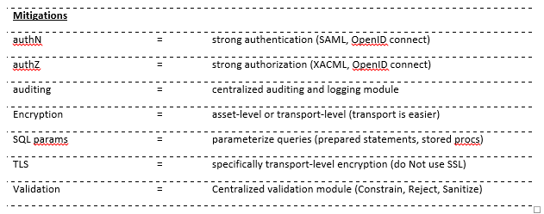
Mitigation Analysis & Verification Lab – Example Mitigations
Notes:
Show this slide during the review. This is also in the Pupil.Exercise Notes document.

